Slide 1
Java SDK for CWL
Paul Grosu
___________________________________________________
pgrosu@gmail.com

Slide 2
File Requirements
Java SDK
CommandLineTool.yml
Process.yml
Workflow.yml
metaschema.yml
AUTHORS.txt ( Acknowledgements that get added to each SDK file. )
cwl-sdk-config.txt ( Config file for CWLSDKBuilder. )
CreateCWLJavaSDK.java ( Runs the YAMLParser and CWLSDKBuilder. )
YAMLParser.java ( Parses the YAML files and extracts relevant information. )
CWLSDKBuilder.java ( Generates the SDK based on the YAMLParser data. )
compile-and-run.sh ( Turn-key script that compiles, runs and performs verification. )

Slide 3
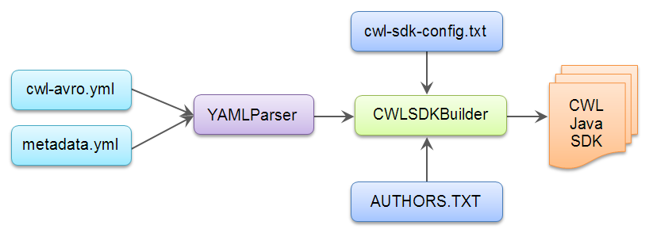
SDK Generating Process
YAMLParser ► Collects the name, type, fields, inheritance and specializations from
the YAML files, which get provided to the CWLSDKBuilder.
YAMLParser ► The CWLSDKBuilder in conjunction with a configuration file called
cwl-sdk-config.txt and AUTHORS.TXT file will generate the SDK in
the directory called sdk.
YAMLParser
CWLSDKBuilder

Slide 4
Configuration File
The cwl-sdk-config.txt file has three options which can be entered on each line:
To override the default class creation:
override : ClassName : interface
To skip the creation of a class:
skip : ClassName
To assign a namespace to a variable:
namespace : VariableName : TheActualNamespaceAssignment

Slide 5
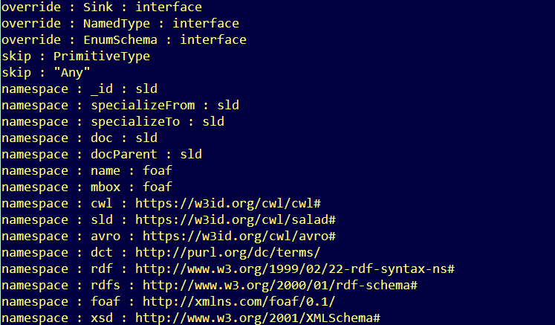
Configuration File

Slide 6
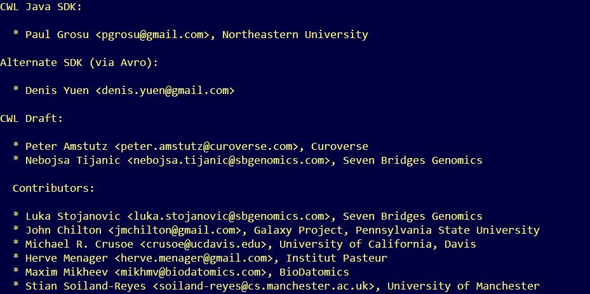
Authors File
The AUTHORS.TXT file is where one can add author acknowledgements.

Slide 7
Running the Program
To compile the programs with Java:
javac YAMLParser.java javac CWLSDKBuilder.java javac CreateCWLJavaSDK.java
To run:
java CreateCWLJavaSDK cwl-yaml-specs/CommandLineTool.yml
cwl-yaml-specs/Process.yml
cwl-yaml-specs/Workflow.yml
cwl-yaml-specs/metaschema.yml

Slide 8
All Steps Together
Below are all the steps together that would need to be run to generate the SDK,
JavaDoc and JAR file:
./step0-download-draft-3-yaml-files.sh
./step1-generate_sdk.sh
./step2-compile-sdk-files-for-jar.sh
./step3-compile-util-files-for-jar.sh
./step4-generate-jar-files.sh
./step5-generate-javadoc.sh

Slide 9
What is new?
Optimized recursion for class creation in CWLSDKBuilder.java
Updated JavaDoc annotations in CWLSDKBuilder.java
New method (updateAbstractFields) in YAMLParser.java for creating
concrete fields
A full example of reading and running a CWL file and associated input file
located in the examples directory
./step0-download-draft-3-yaml-files.sh
./step1-generate_sdk.sh
./step2-compile-sdk-files-for-jar.sh
./step3-compile-util-files-for-jar.sh
./step4-generate-jar-files.sh
./step5-generate-javadoc.sh
Nota bene: There will be some dummy methods generated as does not have
multiple inheritance, so the implemented interfaces required
this workaround. It does not impact the functionality of the SDK
or the correct implementation of the draft specifications.

Slide 10
Demo Q & A Thank you ☺

